Slide 1
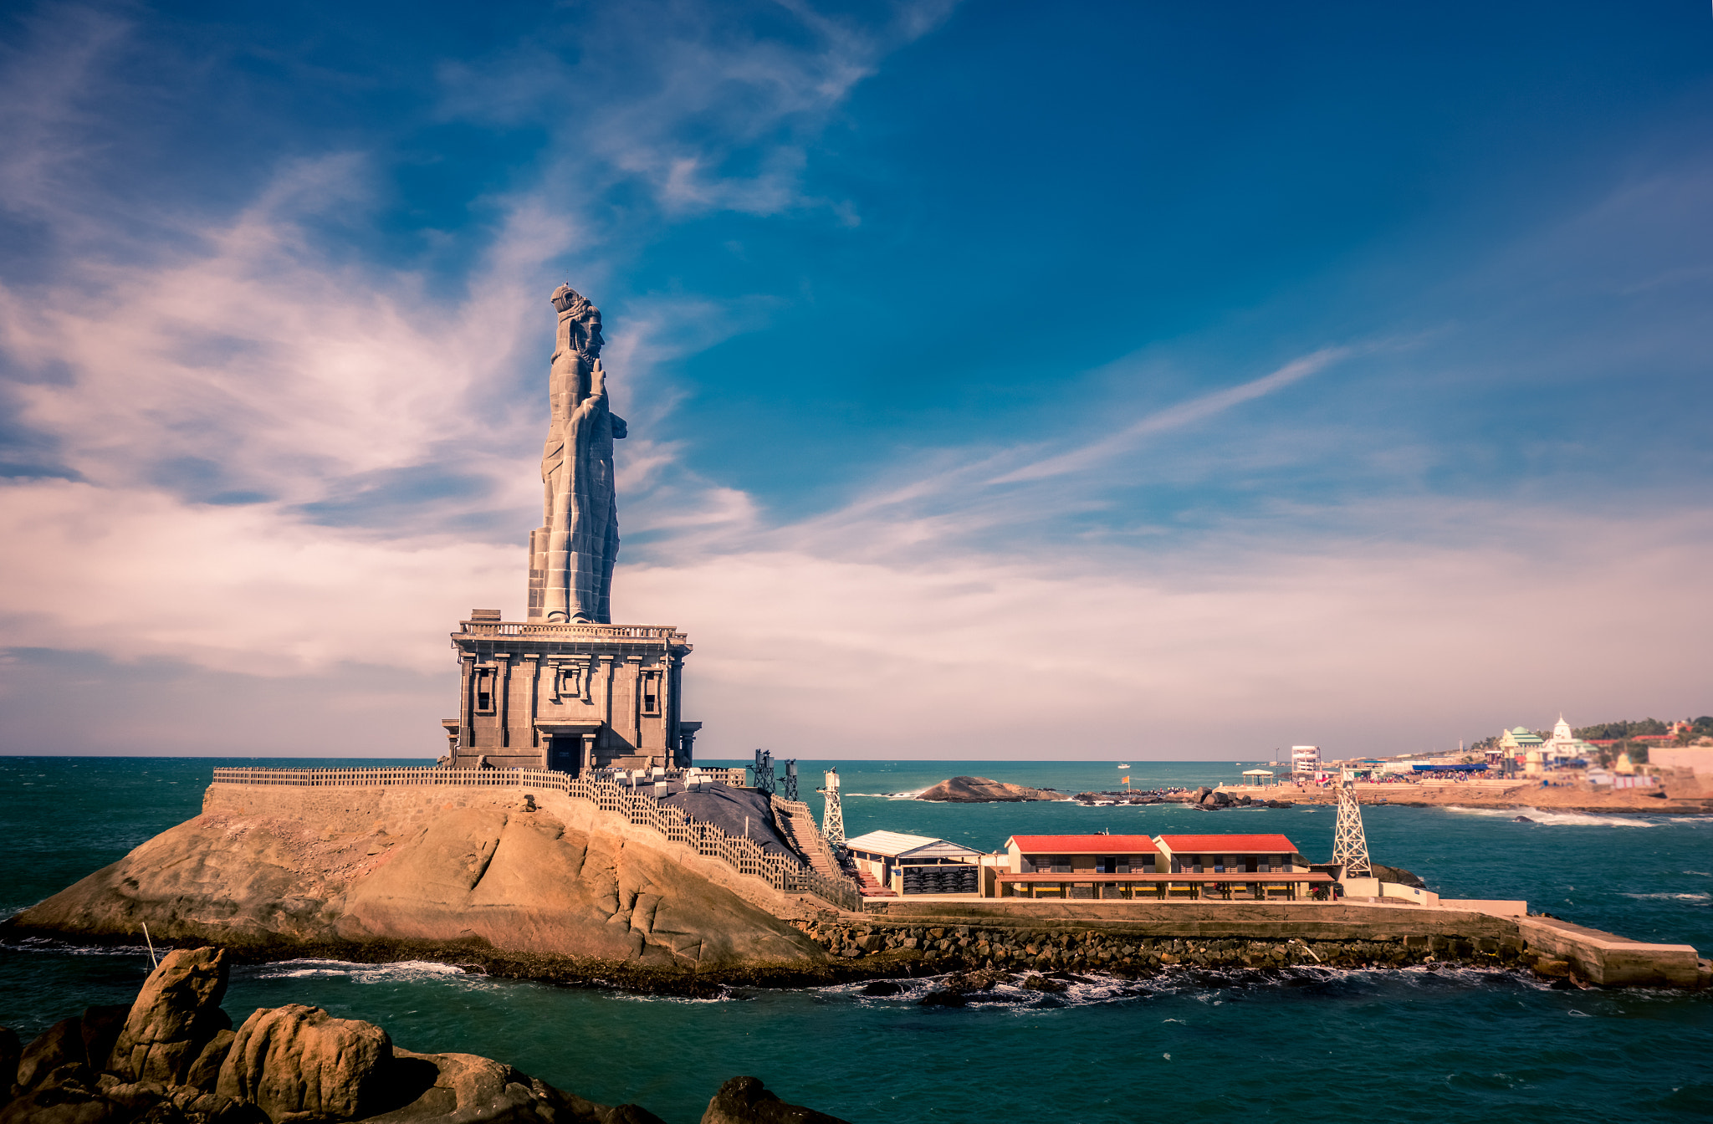
Tourism Management System in kanyakumari
Submitted by
Ashika A L [ 20223091401220]
Asna tryphosa S [20223091401221]
Anushya B [20223091401219]
Devika A S [20223091401225]

Slide 2
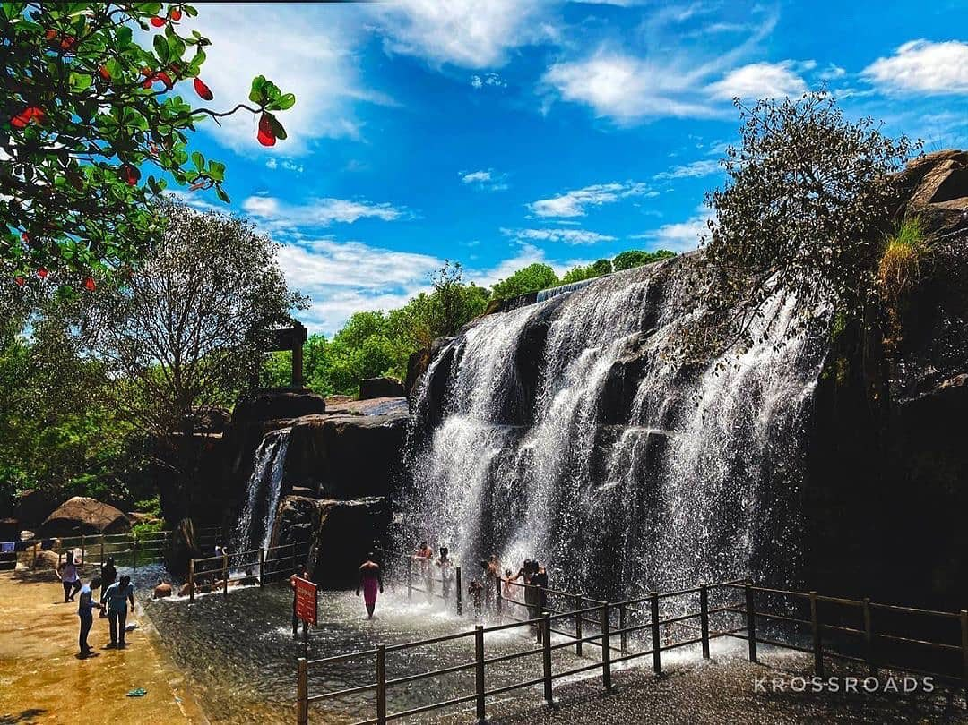
ABSTRACT
The tourism management system for Kanyakumari aims to enhance the efficiency and effectiveness of managing tourism activities in the region.
This project focuses on developing a comprehensive software solution that automates various processes related to tourism management.
the tourism management system aims to improve the overall experience for tourists visiting Kanyakumari, while also supporting the growth and development of the local tourism sector.

Slide 3
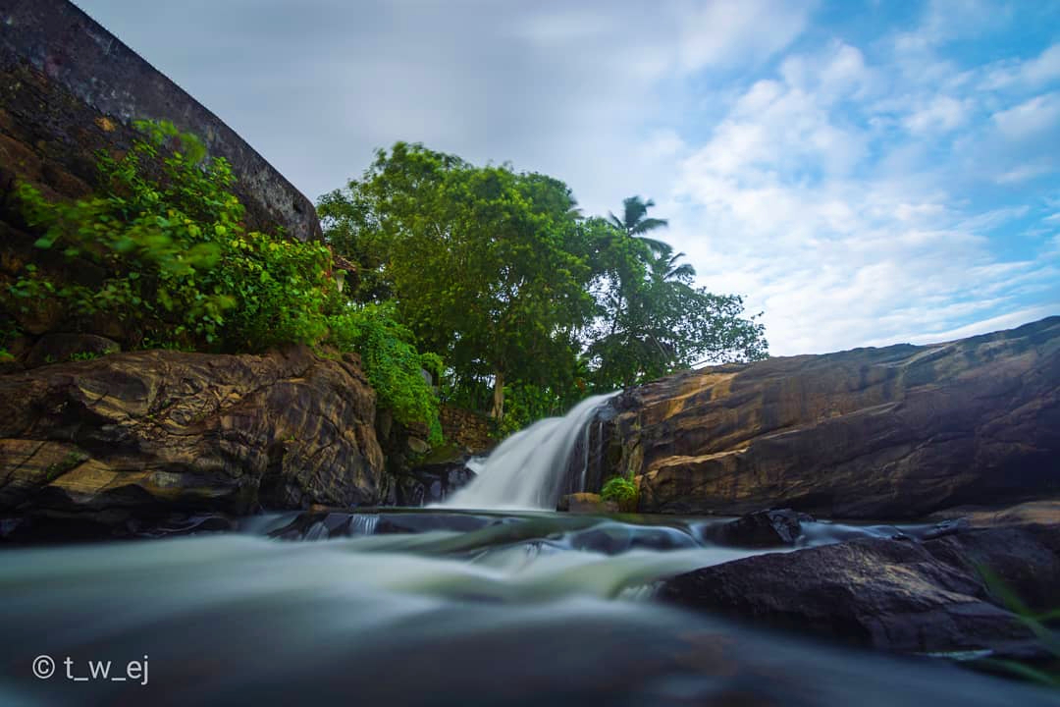
PROJECT PROFILE
The Tourism Management System for Kanyakumari is an exceptionally sophisticated platform meticulously crafted to optimize the management of tourism-related activities through the effective utilization of PHP and MySQL database.
This innovative system is designed to offer an extensive array of features that significantly enhance the experience for both tourists and administrators.
The primary objectives of this project are to facilitate a seamless booking experience for tourists, enabling them to view and book a diverse range of tour packages, and to provide a secure, user-friendly interface for signing in and signing up.

Slide 4
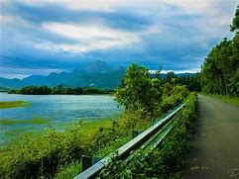
AIM
The primary aim of the Tourism Management System for Kanyakumari project is to create an efficient, user-friendly, and comprehensive platform that enhances the management and experience of tourism-related activities in the region.

Slide 5
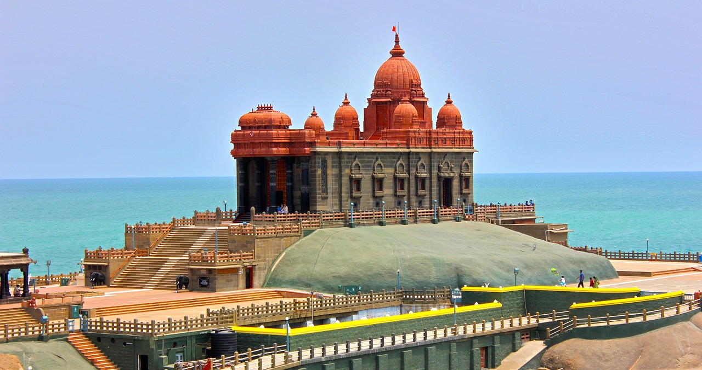
OBJECTIVE
This system aims to streamline the booking process by allowing tourists to effortlessly browse and book a wide array of tour packages. With a secure and intuitive interface for sign-in and sign-up, the platform ensures that tourists can access and utilize the services with confidence and ease.
Administrators are equipped with powerful functionalities to manage and update tour packages efficiently, significantly reducing manual effort and minimizing potential errors.

Slide 6
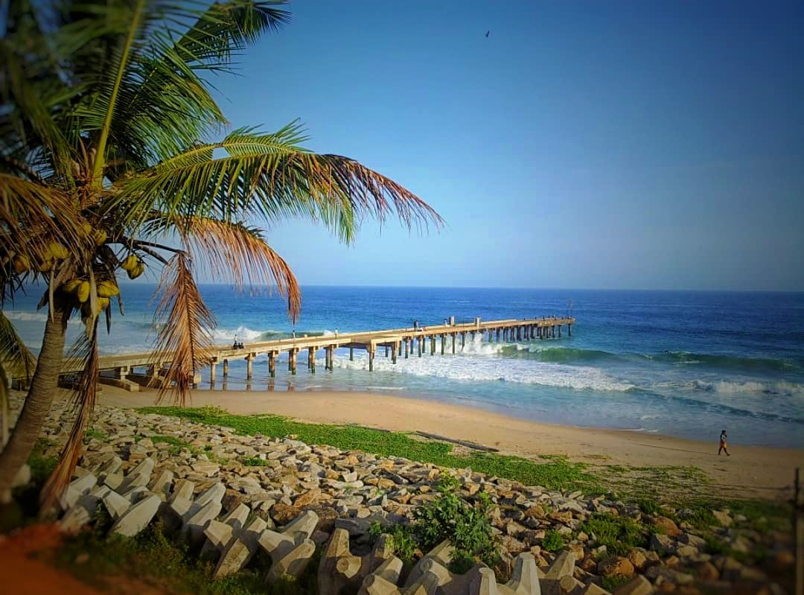
MOTIVATION
Kanyakumari, being a prime tourist destination known for its stunning landscapes, cultural heritage, and unique geographical location at the southern tip of India, attracts a significant number of visitors each year.
However, the management of tourism-related activities can be challenging due to the high volume of tourists and the need for efficient and effective coordination.

Slide 7
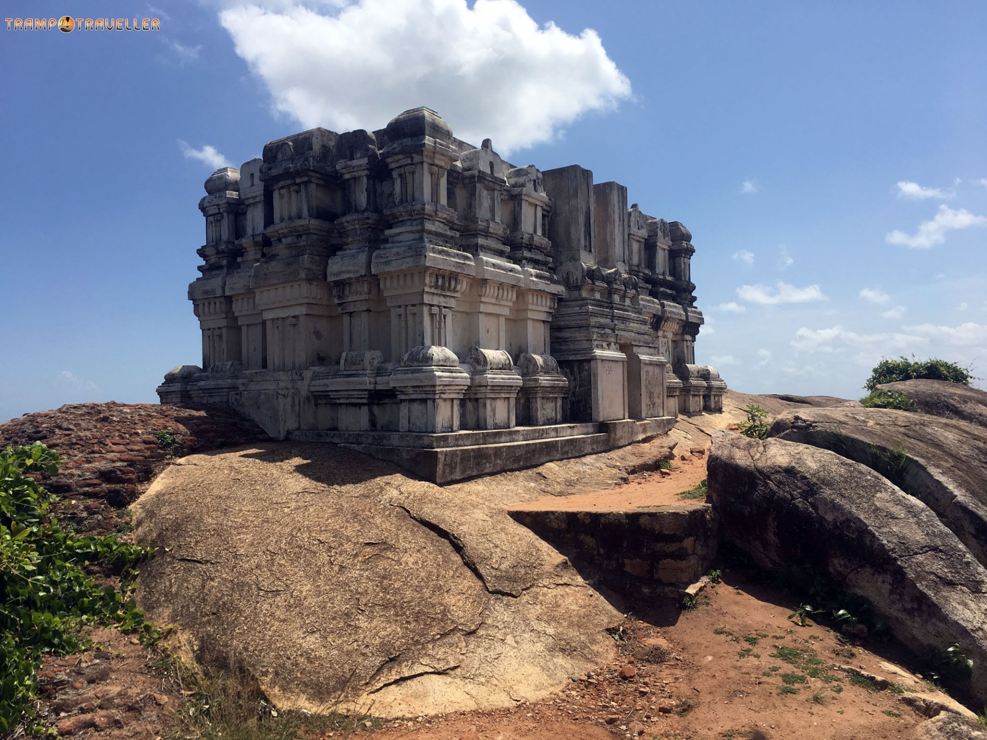
EXISTING SYSTEM AND DISADVANTAGES
Generating reports is a labor-intensive and time-consuming task in the current system.
Time-consuming tasks such as generating reports and updating records.
Limited accessibility and difficulty in sharing information remotely

Slide 8
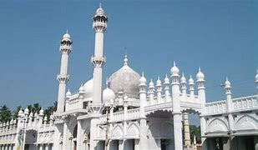
PROPOSED SYSTEM AND ADVANTAGES
➢User-friendly interface for tourists and administrators.
➢Reduction in manual effort and errors.
➢Easy generation of reports and analytics.
➢Minimal paperwork, leading to increased efficiency.
➢Automatic handling of bookings and enquiries.

Slide 9
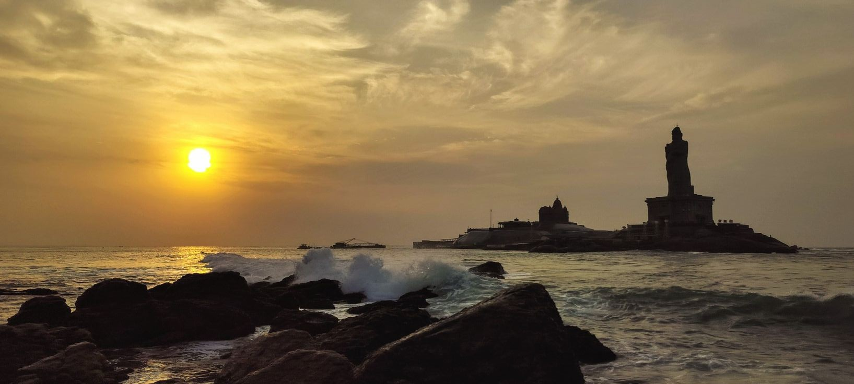
FRONTEND BACKEND SELECTION
HTML,CSS,JAVASCRIPT,BOOTSRAP as the front-end for developing our project.
PHP AND MYSQL as the front-end for developing our project.

Slide 10
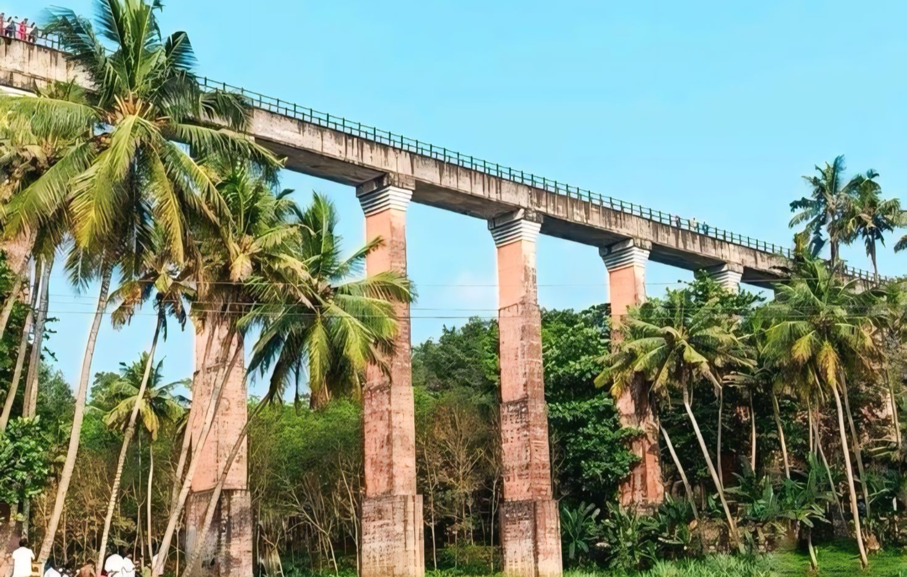
System Requirments
Hardware Requirement | software Requirement
Processor : intel core i3 | Operating system : Window 11
Mother Board : Intel 945G ExpressChip-set | Tool Used : Visual Studio 2010
Bus Speed : 2.80GHZ | FrontEnd :HTML,CSS,JAVASCRIPT,BOOTSTRAP.
RAM : 2GB | Backend : PHP,MYSQL
Hard disk : 20GB or more
Monitor : 17”inch CRT (IBM)
Keyboard : 104 Keys
Mouse : Lenovo PS/2 3 Buttons

Slide 11
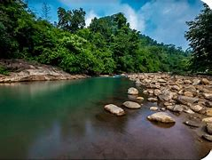
SYSTEM DESIGN
The Tourism Management System for Kanyakumari is designed to provide an efficient platform for tourists, businesses, and tourism authorities. It follows a three-tier architecture with a user-friendly interface for bookings, itinerary management, and real-time tourist information.

Slide 12
DFD LEVEL 0
Report
Report
TMS
Tourism management system-kanyakumari
Admin/user
Details
Details

Slide 13
DFD LEVEL 1
Admin Dashboard
Valid
Add/Modify
Manage Enquiry
tblenquiry
Admin
Login
Valid
Add/Modify
table issues
tblissues
Valid
Add/Modify
Booking
tblbooking
Admin
Valid
Add/Modify
Packages
tblpackages
Valid
Manage Packages
Add/Modify
Valid
Manage Profile
tbluser
Valid
Manage Users

Slide 14
DFD LEVEL 2
Signin
View profile
tbluser
Registered user
Manage booking
tblbooking
Users
View packages
tblpackages
Guest user
Visit wbesite content
tblpages
Enquirey
tblenquirey
Register

Slide 15

SYSTEM ARCHITECTURE
Register
Request
User interface
View website content
Response
Tms
View packages
Manage bookings
Enquiry
User
Client side
Server side

Slide 16
Password
Signin/signup
TMS-KK
id
UserName
ER DIAGRAM
Id
Password
Reg Date
Updation Date
Fullname
Admin
Mobile NO
Updationdate
Raise
User
Add
Email
Book
Packages
Issues
Manage
PackageDetails
postingDate
AdminRemark
Package Name
Package id
Package type
PackageImage
AdminRemarkDate
Id
PackageLocation
CreationDate
UserEmail
Description
Packageprice
UpdationDate
issue

Slide 17
DataBase Design
ADMIN LOGIN
FIELD NAME | DATA TYPE | DESCRIPTION
ID | NUMBER | ID NUMBER
USER NAME | TEXT | USER NAME
PASSWORD | TEXT | PASSWORD
UPDATION DATE | DATE | UPDATION DATE

Slide 18
TOURPACKAGE TABLE
FIELD NAME | DATA TYPE | DESCRIPTION
PACKAGE ID | NUMBER | PACKAGE ID
PACKAGE NAME | TEXT | PACKAGE NAME
PACKAGE TYPE | TEXT | PACKAGE TYPE
PACKAGE LOCATION | TEXT | PACKAGE LOCATION
PACKAGE PRICE | NUMBER | PACKAGE PRICE
PACKAGE FEATURES | TEXT | PACKAGE FEATURES
PACKAGE DETAILS | TEXT | PACKAGE DETAILS
PACKAGE IMAGE | IMAGE | PACKAGE IMAGE
CREATION DATE | TEXT | CREATION DATE
UPDATION DATE | TEXT | UPDATION DATE

Slide 19
BOOKING TABLE
FIELD NAME | DATA TYPE | DESCRIPTION
BOOKING ID | NUMBER | BOOKING ID
PACKAGE ID | NUMBER | PACKAGE ID
USER EMAIL | TEXT | USER EMAIL
FROM DATE | TEXT | FROM DATE
TO DATE | TEXT | TO DATE
COMMENT | TEXT | COMMENT
REGDATE | TEXT | REGISTERATION DATE
STATUS | TEXT | STATUS
CANCELLED BY | TEXT | CANCELLED BY
UPDATION DATE | TEXT | UPDATION DATE

Slide 20
ISSUES TABLE
FIELD NAME | DATA TYPE | DESCRIPTION
ID | NUMBER | ID
USER NAME | TEXT | USER NAME
ISSUE | TEXT | ISSUE
DESCRIPTION | TEXT | DESCRIPTION
POSTINGDATE | TEXT | POSTINGDATE
ADMIN REMARK | TEXT | ADMIN REMARK
ADMIN REMARK DATE | TEXT | ADMIN REMARK DATE

Slide 21
USER TABLE
FIELD NAME | DATA TYPE | DESCRIPTION
ID | NUMBER | IDNUMBER
FULLNAME | TEXT | FULL NAME
MOBILE NUMBER | NUMBER | MOBILE NUMBER
EMAIL ID | TEXT | EMAIL ID
PASSWORD | TEXT | PASSWORD
REGDATE | DATE | REGISTRATION DATE
UPDATION DATE | DATE | UPDATION DTAE

Slide 22
ENQUIRY TABLE
FIELD NAME | DATA TYPE | DESCRIPTION
ID | NUMBER | ID
FULL NAME | TEXT | FULL NAME
EMAIL ID | TEXT | EMAIL ID
MOBILE NUMBER | NUMBER | MOBILE NUMBER
SUBJECT | TEXT | SUBJECT
DESCRIPTION | TEXT | DESCRIPTION
POSTING DATE | TEXT | POSTING DATE
STATUS | TEXT | STATUS
PAGES TABLE
FIELD NAME | DATA TYPE | DESCRIPTION
ID | NUMBER | ID
TYPE | TEXT | TYPE
DETAILS | TEXT | DETAILS

Slide 23
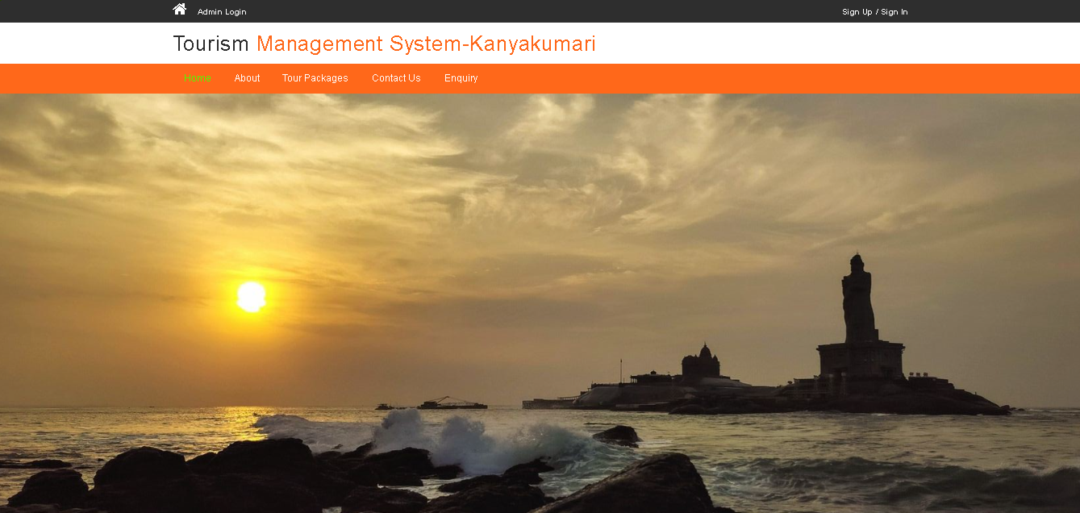
SYSTEM IMPLEMENTATION
Home page

Slide 24
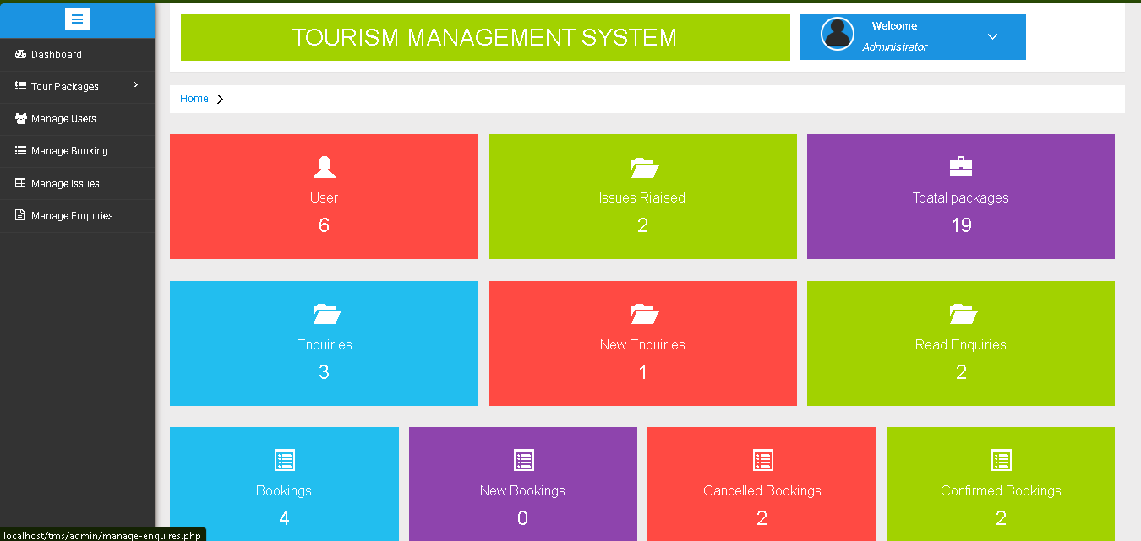
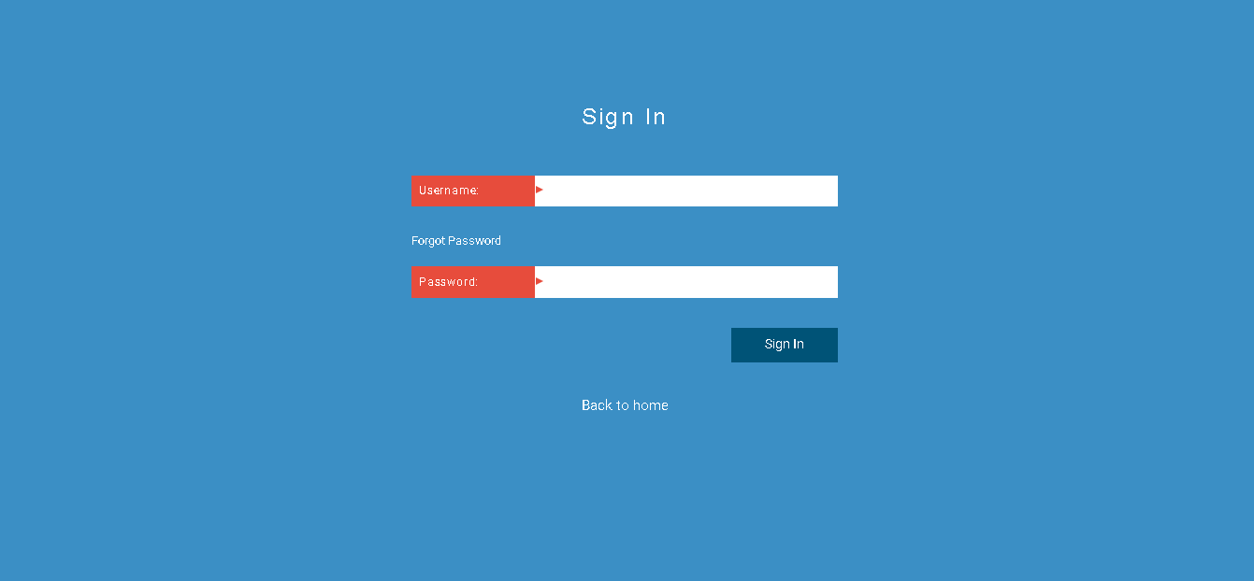
ADMIN DASH BORD

Slide 25
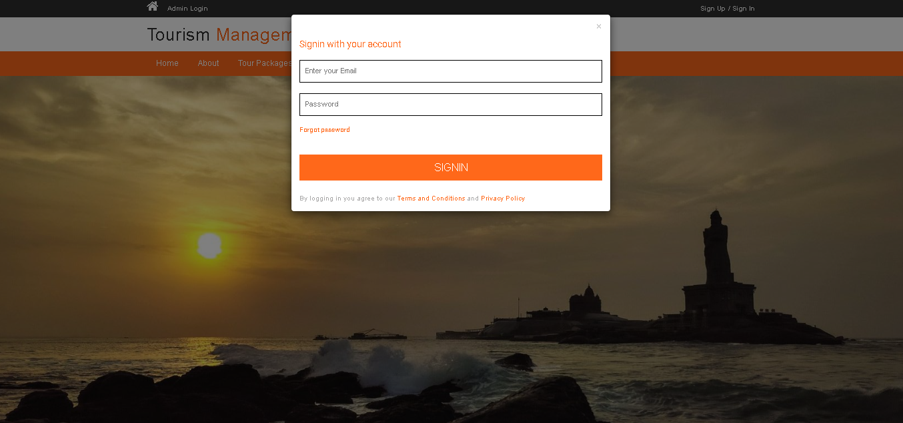
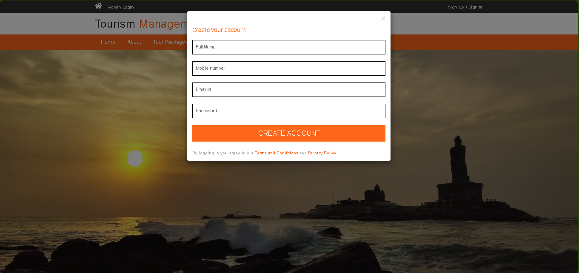
SIGNIN AND SIGNUP PAGE

Slide 26
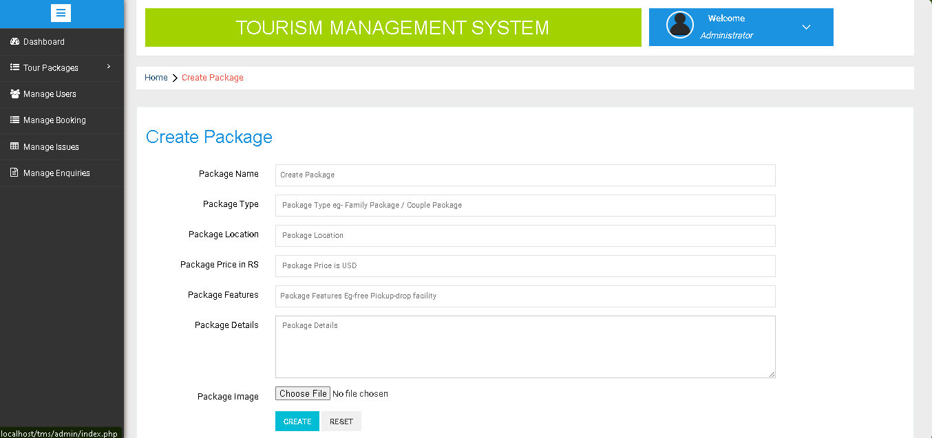
CREATING PACKAGES

Slide 27
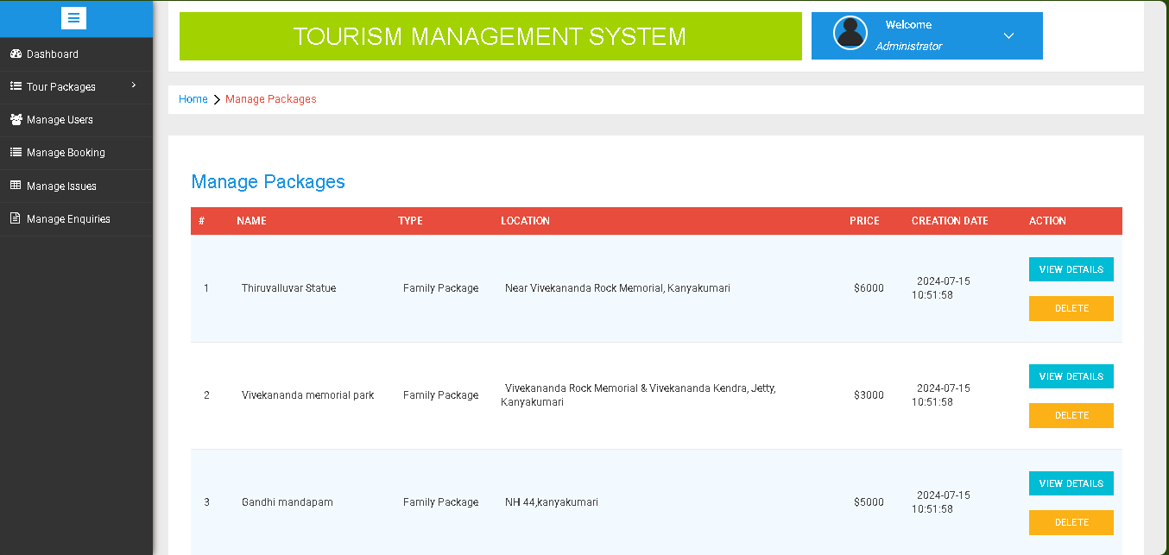
MANAGE PACKAGES

Slide 28
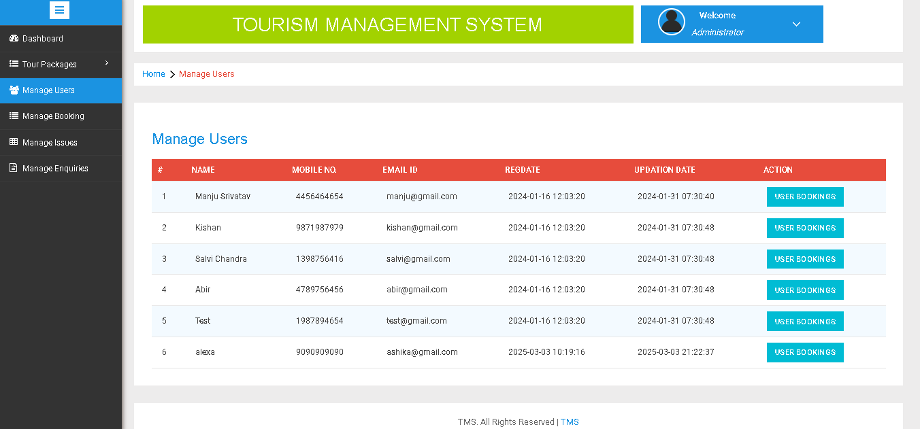
MANAGE USERS

Slide 29
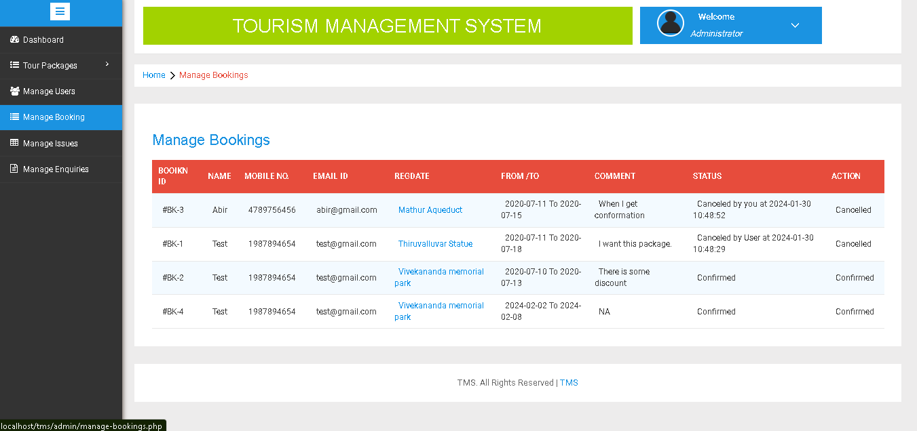
MANAGE BOOKING

Slide 30
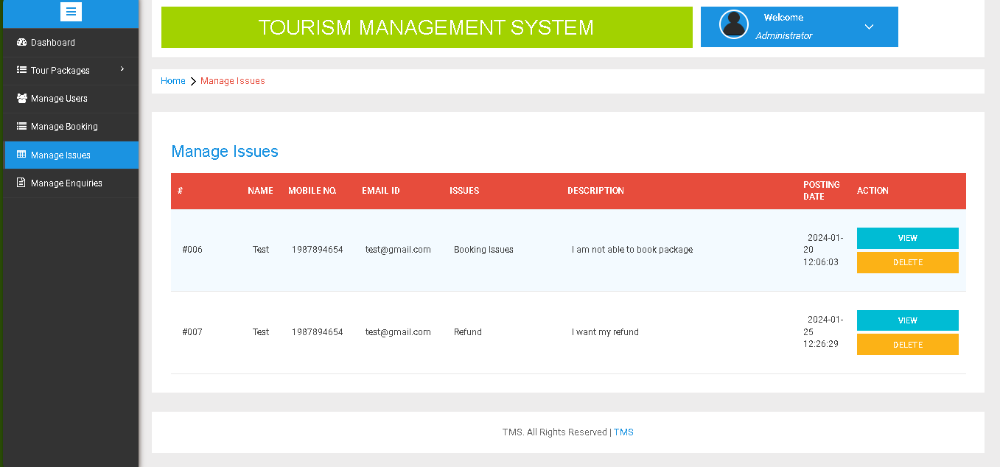
MANAGE ISSUES

Slide 31
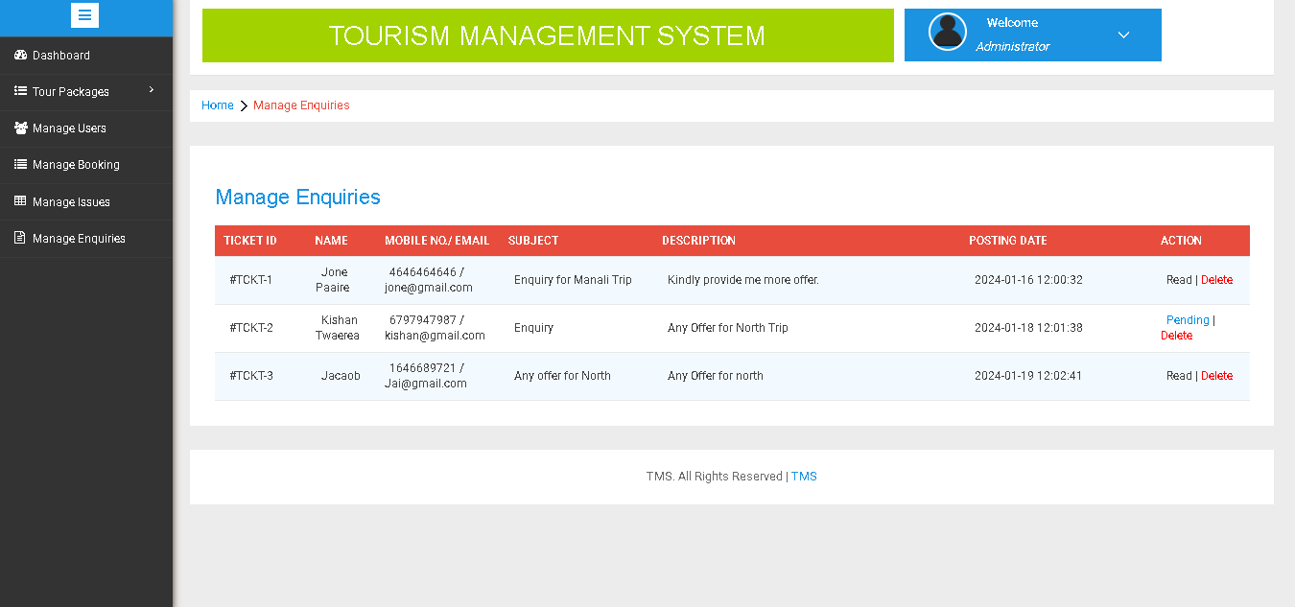
MANAGE ENQUIRIES

Slide 32
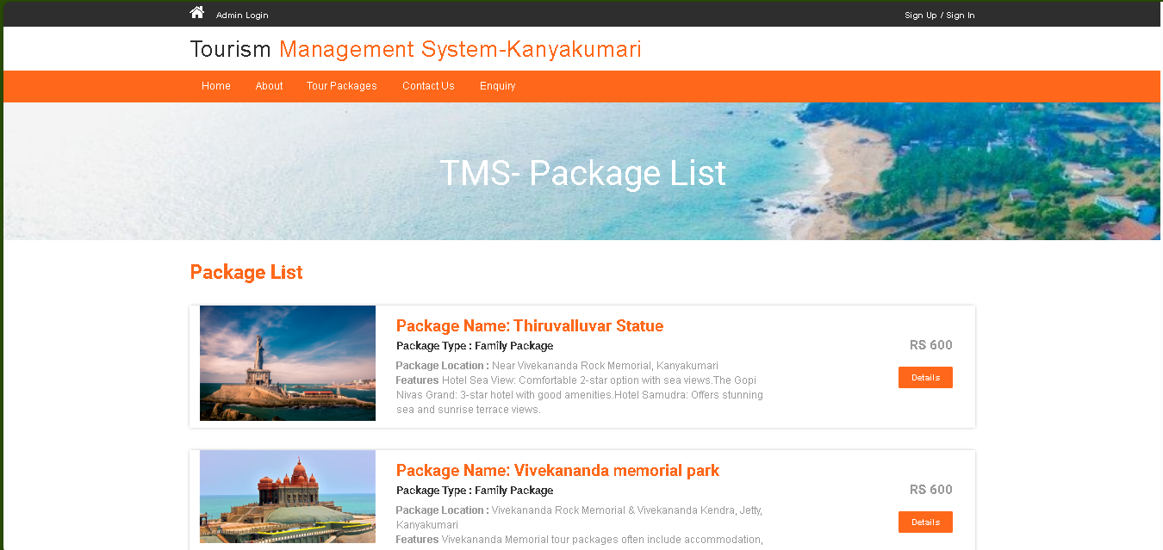
PACKAGE LIST

Slide 33
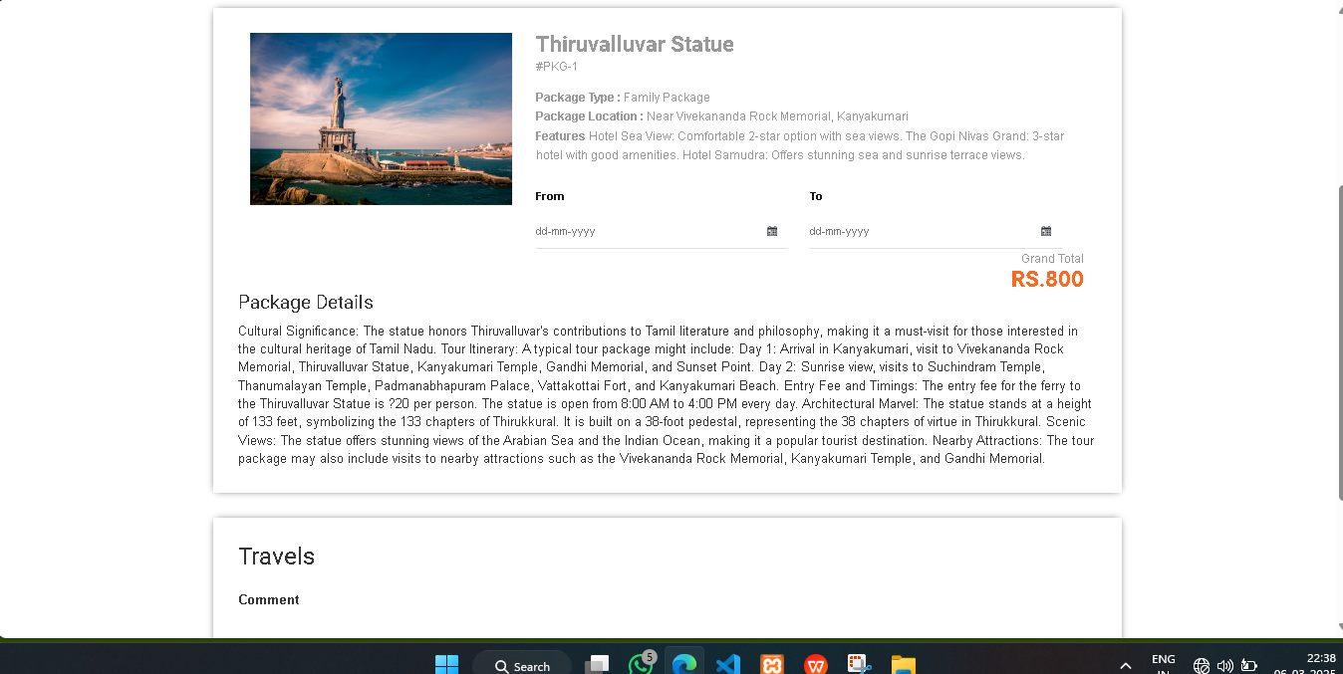
PACKAGE DETAILS

Slide 34
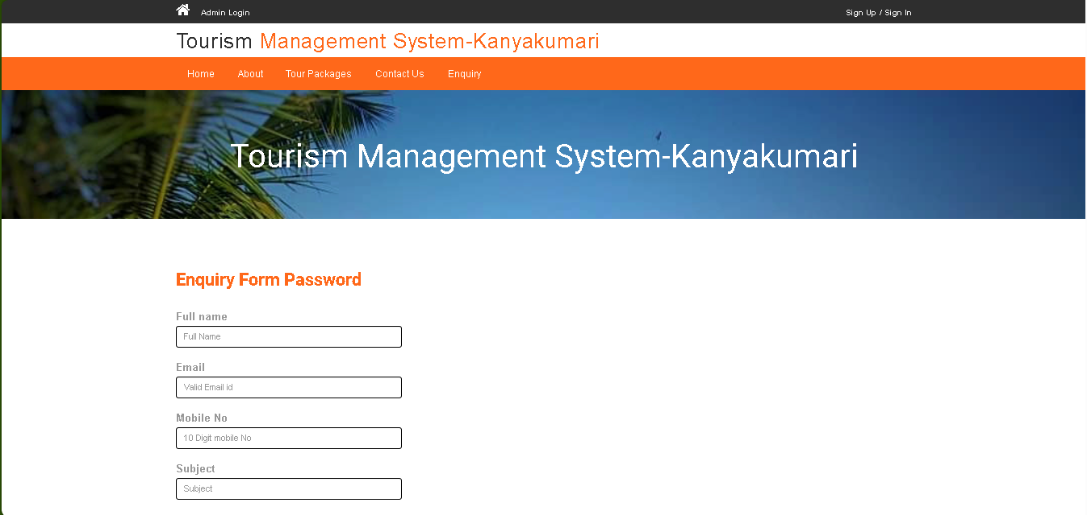
ENQUIRY FORM

Slide 35
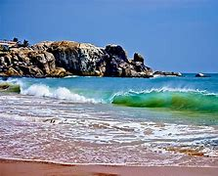
PROJECT DESCRIPTION MODULE
ADMINISTRATOR MODULE
The Administrator Module is responsible for managing all aspects of the system, including travel packages, bookings, user management, and handling inquiries or complaints. The admin has full access to modify and maintain the system.
USER (TRAVELER) MODULE
The User (Traveler) Module allows registered travelers to book and manage their trips efficiently. Users can maintain their profiles, book tours, and raise issues regarding their bookings.
GUEST USER MODULE
The Guest User Module allows visitors to explore the website, view available travel packages, and make inquiries without registration.

Slide 36
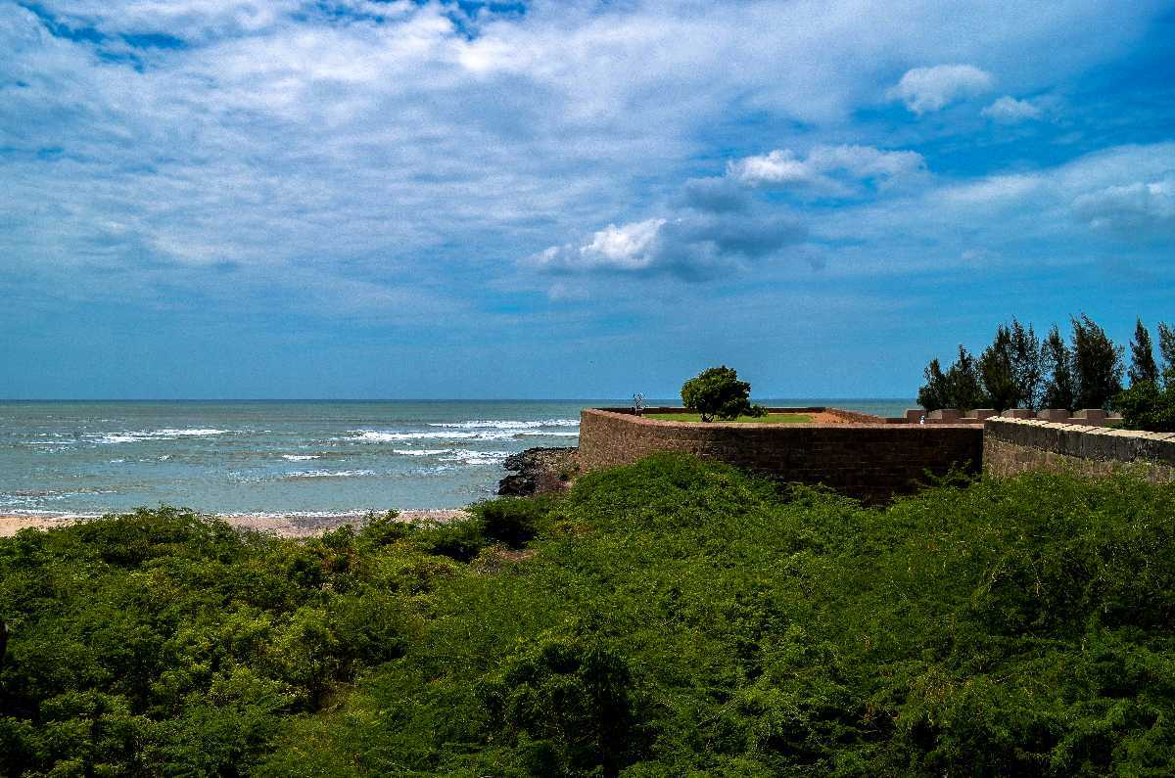
CONCLUSION
The deployment of this software has significantly enhanced the efficiency of managing tourism activities in Kanyakumari. It simplifies data maintenance, streamlines administrative processes, and generates detailed reports that assist in informed decision-making. The system ensures that accurate and timely information is always accessible to both management and tourists.

Slide 37
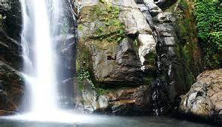
FUTURE ENHANCEMENT
Develop a mobile application for tourists to easily access travel plans, attraction details, and booking facilities.
Use AI to recommend personalized itineraries and optimize crowd management at popular tourist spots.
Integrate the system with existing travel platforms for seamless ticketing, accommodation, and transport booking.

Slide 38
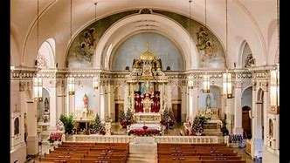
ONLINE REFERENCE
[www.incredibleindia.org](https://www.incredibleindia.org)
[www.tamilnadutourism.tn.gov.in](https://www.tamilnadutourism.tn.gov.in)
[www.kanyakumaritourism.com](https://www.kanyakumaritourism.com)

Slide 39
THANKYOU

